Slide 1
CS212-Object Oriented Programming
Lecture 06
Static Variables and Methods

Slide 2
class Circle {
double radius;
Circle(double newRadius) {
radius = newRadius;
}
double getArea() {
return Math.pow(radius, 2) * Math.PI;
}
}
Circle
radius: double
Circle(newRadius: double)
getArea(): double
public class CircleDemo {
public static void main(String[] args) {
Circle myCircle = new Circle(10.0);
Circle yourCircle = new Circle(25.0);
Circle theirCircle = new Circle(125.0);
System.out.printf(
"Radius: %.2f; Area: %.2f\n",
myCircle.radius,
myCircle.getArea()
);
}
}
myCircle: Circle
Classes and Objects
radius: 10
yourCircle: Circle
radius: 25
theirCircle: Circle
radius: 125
Notes:
In the previous lecture, we discussed classes as templates for instantiating objects.
Like in this case, from the Circle class, three objects or circle instances have been created. Each objects has its own state and behavior
The state is defined by the value of its attribute radius
Whereas the behavior is invoked by calling the getArea method
So far, the attributes and methods we have discussed have been associated with objects or instances of class. In this lecture the concept will be exerted to class variables and class methods.
Even in this example, unlike the getArea method that was invoked on the myclass object instance,
we see the method pow invoked on class Math without creating an object of the class.
this pow is a static method
Similarly, PI is a static variable, since we got the value without instantiating an object of the Math class

Slide 3
Instance vs. Class Variables
Instance variable are those variables that are associated with each object uniquely.
Each instance of the class will have its own copy of each of these variables.
Each object will have its own values for each instance variable that differentiate one object from the other of the same class type.
Declared in the usual way and can have an initial value specified.
Class variables are associated with the class and is shared by all objects of the class.
There is only one copy of each of these variables no matter how many class objects are created.
They exist even if no objects of class have been created.
These variables are also called static fields because we use the keyword static when we declare them.
Notes:
Lets look at the difference between instance and class variables.

Slide 4
Static Variables
Class variables are also called static variables because we use the keyword static when we declare them.
The static variable gets memory only once in class area at the time of class loading*
When & Why do we use Static Variables?
to refer the common property of all objects (that is not unique for each object)
E.g. company name of employees, college name of students..
It makes the program memory efficient (saves memory)
to keep count of certain events
E.g. Number of objects created for a certain class
Notes:
* In the case of instance variable, a copy is created for each object/ instance of the class.

Slide 5
Static Variables: Example 1
class Student {
int rollno;
String name;
static String college = "MCS";
Student(int r, String n) {
rollno = r;
name = n;
}
void Display( ) {
System.out.printf("%d: %s (%s)\n",
rollno, name, college);
}
public static void main(String[] args) {
Student s1 = new Student(111, "Omer");
Student s2 = new Student(222, "Hamza");
s1.Display();
s2.Display();
}
}
Notes:
In this example, we have a class student with instances s1 and s2
the college attribute is common for all students and therefore defined as a static variable
This way, it is only allocated memory once
The function display will run for each student and display MCS as the college name

Slide 6
Static Variables: Example 2
class Counter {
// will get memory only once
// and retain its value
static int count = 0;
Counter() {
count++;
System.out.println(count);
}
public static void main(String[] args) {
Counter c1 = new Counter();
Counter c2 = new Counter();
Counter c3 = new Counter();
}
}
Notes:
In this example we have a class counter with a static variable count. Since this variable is associated with the class and therefore only defined once, we can use it to count the number of objects/ instances created for the counter class. The code for this is written in the constructor
Thus for each counter created, the count value is incremented.

Slide 7
Instance vs. Class Methods
Instance methods can only be executed in relation to a particular object.
If no object exists, no instance method can be executed.
Class methods can be executed even when no objects of a class exist.
Like class variables, these are declared using the keyword static, so also called static methods.
Notes:
Now lets have a look at the difference between instance and class methods.

Slide 8
Static Methods
A static method belongs to the class rather than object of a class.
A static method can be invoked without the need for creating an instance of a class.
Static method can access static data members and can change their value.
Restrictions for static method
The static method can not use non-static data members or call non-static methods directly.
this and super cannot be used in static context.

Slide 9
Static Methods: Example 1
class Student {
int rollno;
String name;
static String college = "EME";
static void Change() {
college = "MCS";
}
Student(int r, String n) {
rollno = r;
name = n;
}
void Display( ) {
System.out.printf("%d: %s (%s)\n",
rollno, name, college);
}
public static void main(String[] args) {
Student.Change(); // Static Method Call
Student s1 = new Student(111, "Omer");
Student s2 = new Student(222, "Hamza");
s1.Display();
s2.Display();
}
}
Notes:
We have the same example of a Student class with static variable college. However, in this case, we also have a static method (change) that changes the value of the static college variable.
Thus in the main body, we can call the Change method directly on the Student class
This action is called a ‘static method call’
In this case, when we invoke the display method on the students s1 and s2; we will get the changed college name.

Slide 10
Static Methods: Example 2
class Circle {
/** The radius of this circle */
double radius;
/** Number of Circle objects */
static int numberOfObjects = 0;
/** Construct a circle object */
Circle() {
radius = 1.0;
numberOfObjects++;
}
/** Construct a circle object */
Circle(double newRadius) {
radius = newRadius;
numberOfObjects++;
}
/** Return Number of Circle objects*/
static int getNumberOfObjects() {
return numberOfObjects;
}
/** Return the area of this circle */
double getArea() {
return Math.pow(radius, 2) * Math.PI;
}
}
Notes:
Now consider the example of the Circle class. We have added a static variable numberOfObjects to count the number of objects created
We have also added a static method getNumberofObjects to return this static variable value

Slide 11
Static Methods: Example 2
public class CircleDemo {
public static void main(String[] args) {
Circle c1 = new Circle();
System.out.println("Before creating c2");
System.out.printf("c1 : radius (%.1f) ", c1.radius);
System.out.printf("and number of Circle objects(%d)\n",
c1.numberOfObjects);
Circle c2 = new Circle(5.0);
c1.radius = 9.0;
// Display c1 and c2 AFTER c2 was created
System.out.print("\nAfter creating c2 and modifying ");
System.out.println("c1\'s radius to 9.0");
System.out.printf("c1 : radius (%.1f) ", c1.radius);
System.out.printf("and number of Circle objects(%d)\n",
c1.numberOfObjects);
System.out.printf("c2 : radius (%.1f) ", c2.radius);
System.out.printf("and number of Circle objects(%d)\n",
c2.numberOfObjects);
System.out.printf("Number of Circle objects(%d)\n",
Circle.numberOfObjects);
}
}
Notes:
The main function demonstrates how the static variable can be accessed. This can be done through the objects which are in this case circles c1 and c2 And also by directly invoking the static method on the Circle class

Slide 12
Static Variables and Methods
instantiate
c1: Circle
Memory
Circle
radius: 1.0
numberOfObjects: 2
1.0
radius: double
numberOfObjects: int
2
Circle()
Circle(newRadius: double)
getNumberOfObjects(): int
getArea(): double
c2: Circle
instantiate
radius: 5.0
numberOfObjects: 2
5.0
UML Notation:
Underline: static variables or methods
Notes:
In the UML notation, static variables and methods are underlined
The diagrammatic representation also shows that the static variable is only allocated memory once
Hence, its value remains the same whether accessed through objects or through the class method

Slide 13
Java static Keyword
The static keyword in java is used mainly for memory management
We can apply Java static keyword with:-
Variable (a.k.a. class variable)
Method (a.k.a. class method)
Block
Nested Class
The static keyword belongs to the class rather than instance of the class
Notes:
Besides variables and methods, the java static keyword can also be applied to blocks and nested classes. ASSIGNMENT

Slide 14
Access Modifiers in Java

Slide 15
Access Modifiers in Java
The access modifiers in Java specifies accessibility (scope) of a data member, method, constructor or class.
Notes:
Uptill now we mainly focused on public data members and methods…. However, if you recall when we discussed Object Orientated Programming concepts, we talked a bit about data encapsulation….
What is data encapsulation?

Slide 16
Data Encapsulation
Provides protection against direct modification of the class data fields
Achieved by making the data fields private.
To provide access to the private data fields, we implement appropriate get and set methods.
class Circle {
public double radius;
public Circle(double r_in) {
if(r_in < 0)
radius = 1;
else
radius = r_in;
}
}
public class CircleDemo {
public static void main(String[] args) {
Circle C1 = new Circle(10.0);
Circle C2 = new Circle(-2);
System.out.printf(C1.radius); // 10
System.out.printf(C2.radius); // 1
C2.radius = -2;
System.out.printf(C2.radius); // -2
}
}
Notes:
Data encapsulation provides protection against direct modification of the class data fields. It is achieved by making the data fields private.
In order to provide access to the private data fields, we implement appropriate get and set methods.
To understand, lets look at a use case… On the left we have a slightly modified constructor in the Circle Class…. Why? Because Radius of a circle cant be negative….
But since we don’t have data encapsulation, we can still assign negative radius.
What is the Solution?

Slide 17
Data Encapsulation
Provides protection against direct modification of the class data fields
Achieved by making the data fields private.
To provide access to the private data fields, we implement appropriate get and set methods.
class Circle {
private double radius;
public Circle(double r_in) {
if(r_in < 0)
radius = 1;
else
radius = r_in;
}
public void setRadius(double r_in){
if(r_in < 0)
radius = 1;
else
radius = r_in;
}
public double getRadius(){
return radius;
}
}
public class CircleDemo {
public static void main(String[] args) {
Circle C1 = new Circle(10.0);
Circle C2 = new Circle(-2);
System.out.printf(C1.getRadius); // 10
System.out.printf(C2.getRadius); // 1
// we cant use C2.radius = -2;
C2.setRadius(-2)
System.out.printf(C2.getRadius());
// 1
}
}
Notes:
Make radius private
Create setRadius method to check assigned value

Slide 18
Access Modifiers in Java
The access modifiers in Java specifies accessibility (scope) of a data member, method, constructor or class.
There are 4 java access modifiers:
private
default
protected
public

Slide 19
The private Access Modifier
The private access modifier is accessible only within class*.
The get and set methods are used to read and modify private properties.
Data fields are made private to protect the data.
Role of Private Constructor
If you make all class constructors private, you cannot create the instance of that class from outside the class#.
Private Constructor is used for creating singleton class and controlled object creation once specific conditions are met.
Notes:
* It is used for data encapsulation
# because a constructor is required to create an object of the class and if it is private, it cannot be called from e.g. the main function
There are use cases for this such as…. Singleton class

Slide 20
public class SingleTonClass {
//Static Class Reference
private static SingleTonClass obj=null;
private SingleTonClass(){
/*Private Constructor will prevent
* the instantiation of this class directly*/
}
public static SingleTonClass objectCreationMethod(){
if(obj==null){
obj= new SingleTonClass();
}
return obj;
}
public void display(){
System.out.println("Singleton class Example");
}
public static void main(String args[]){
//Object cannot be created directly due to private constructor
//This way it is forced to create object via our method where
//we have logic for only one object creation
//both myobj1 and myobj2 point same object obj
SingleTonClass myobj1 = SingleTonClass.objectCreationMethod();
myobj1.display();
SingleTonClass myobj2 = SingleTonClass.objectCreationMethod();
myobj2.display();
} }
Singleton Class
Notes:
A singleton class is a class that can have only one object (an instance of the class) at a time. After the first time, if we try to instantiate the Singleton class, the new variable also points to the first instance created.

Slide 21
public class ControlledCircle {
private int radius;
private ControlledCircle(int r){
radius = r;
}
public static ControlledCircle create(int r){
if(r < 0)
return null;
else
return new ControlledCircle(r);
}
public double getArea(){
return 3.14 * r * r;
}
public static void main(String args[]){
//Creating circle object with negative radius returns null
ControlledCircle cir1 = ControlledCircle.create();
cir1.display(); //Compile Time Error
ControlledCircle cir2 = ControlledCircle.create();
cir2.display();
}
}
Controlled Object Creation
Notes:
Object of ControlledCircle is created if radius is non-negative.
If radius is negative, then null is returned.
This is achieved by making the constructor private and implementing a static method create to make objects which call the constructor after validating the passed radius r.

Slide 22
The private Access Modifier
class A {
private int data = 40;
private void msg() {
System.out.println("Hello Java");
}
}
public class PrivateDemo {
public static void main(String[] args) {
A obj = new A();
System.out.println(obj.data); //Compile Time Error
obj.msg(); //Compile Time Error
}
}

Slide 23
The Default Access Modifier
If you don't use any modifier, it is treated as default access modifier implicitly.
The default modifier is accessible only within package.
By default, the class, variable, or method can be accessed by any class in the same package.
package myPack;
class A {
void msg() { System.out.println("Hello"); }
}
package yourPack;
import myPack.*;
class B {
public static void main(String[] args {
A obj = new A(); //Compile Time Error
obj.msg(); //Compile Time Error
}
}

Slide 24
The protected Access Modifier
Variables, methods, and constructors, which are declared protected in a superclass can be accessed only by the subclasses in other package or any class within the package of the protected members' class.
Protected access modifier is used during inheritance to restrict access of variables, methods and constructors to derived classes. (we shall study it in detail in subsequent lectures).

Slide 25
The public Access Modifier
The public access modifier is accessible everywhere.
It has the widest scope among all other modifiers.
The class, data, or method is visible to any class in any package.
package myPack;
public class A {
public void msg() { System.out.println("Hello"); }
}
package yourPack;
import myPack.*;
class B {
public static void main(String[] args {
A obj = new A();
obj.msg();
}
}

Slide 26
Summary of Access Modifiers
Access Modifier | Within Class | Within Package | Outside Package by subclass Only | Outside Package
Private | Yes | No | No | No
Default | Yes | Yes | No | No
Protected | Yes | Yes | Yes | No
Public | Yes | Yes | Yes | Yes

Slide 27
Example of Data Field Encapsulation
Circle
–radius: double
–numberOfObjects: int
The radius of this circle.
The number of circle objects created.
Constructs a default circle object.
Constructs a circle object with specified radius.
Returns the radius of this circle.
Sets a new radius for this circle.
Returns the number of circle objects created.
Returns the area of this circle.
+Circle()
+Circle(newRadius: double)
+getRadius(): double
+setRadius(newRadius: double): void
+getNumberOfObjects(): int
+getArea(): double

Slide 28
Example of Data Field Encapsulation
public class Circle {
private double radius;
private static int numberOfObjects = 0;
public Circle() {
radius = 1.0;
numberOfObjects++;
}
public Circle(double newRadius) {
radius = newRadius;
numberOfObjects++;
}
public double getRadius() {
return radius;
}
public void setRadius(double newRadius) {
radius = newRadius;
}
public static int getNumberOfObjects() {
return numberOfObjects;
}
public double getArea() {
return Math.pow(radius, 2) * Math.PI;
}
}

Slide 29
Immutable Objects and Classes
If the contents of an object cannot be changed once the object is created, the object is called an immutable object and its class is called an immutable class.
If we delete the set method in the Circle class in the preceding example, the class would be immutable because radius is private and cannot be changed without a set method.
A class with all private data fields and without mutators is not necessarily immutable. For example, the class Student on next slide has all private data fields and no mutators, but it is mutable.

Slide 30
Immutable Objects and Classes
class Student {
private int id;
private BirthDate birthDate;
public Student(int ssn, int day, int month, int year) {
id = ssn;
birthDate = new BirthDate(day, month, year);
}
public int getId() { return id; }
public BirthDate getBirthDate() { return birthDate; }
}
class BirthDate {
private int day;
private int month;
private int year;
public BirthDate(int d, int m, int y) {
day = d; month = m; year = y;
}
public void setYear(int y) { year = y; }
}
public class Test {
public static void main(String[] args) {
Student student = new Student(111, 12, 10, 1999);
BirthDate date = student.getBirthDate();
date.setYear(2018); // Now the student birth year is changed!
}
}

Slide 31
Immutable Class
For a class to be immutable, it must mark all data fields private and provide no mutator methods and no accessor methods that would return a reference to a mutable data field object.

Slide 32
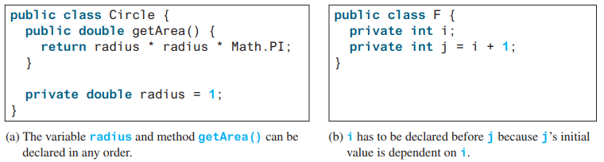
The Scope of Variables
The scope of instance and static variables is the entire class, regardless of where the variables are declared. `

Slide 33
Topics Covered
Study Chapter 9 of course book along with lecture notes 5 and 6
Defining classes for objects
Use of constructor
Access Modifiers
Data Encapsulation and Get & Set Methods
Class/ Static Methods and Variables
Passing Objects to Methods
Arrays of Objects
Immutable Objects
Private Constructors
Java Classes Date and Random

Slide 34
Class Point
Create class point with following features :-
Private X, Y coordinates data members
Requisite Constructors
Instance Method to compute distance between two Points
Static Method to compute distance from x1, y1, x2, y2
Requisite get and set methods for X,Y data members
Maintains count to number of objects created

Slide 35

The this keyword in Java
public class Point {
private int x, y;
private static int count = 0;
public Point(){
this.x = 0; this.y = 0;
count++;
}
public Point(int _x, int _y){
this.x = _x; this.y = _y;
count++;
}
public Point(Point P){
this.x = P.x; this.y = P.y;
count++;
}
public double getDist(Point P){
return Math.sqrt( Math.pow(this.x-P.x,2) +
Math.pow(this.y-P.y,2));
}
public static int getCount(){
return Point.count;
}
public int getX(){
return this.x;
}
public int setX(int _x){
return this.x = _x;
}
//Similarly implement for Y
public static double getDist(int x1, int y1, int x2, int y2){
return Math.sqrt(Math.pow(x1-x2, 2) + Math.pow(y1-y2, 2));
}
}
public class OOPintro {
public static void main(String[] args) {
Point p1 = new Point();
Point p2 = new Point(4,3);
double dist = p1.getDist(p2);
System.out.println("Distance: "+dist);
Point p3 = new Point(p1);
System.out.println("Objects Created: " + Point.getCount());
}
}

Slide 36
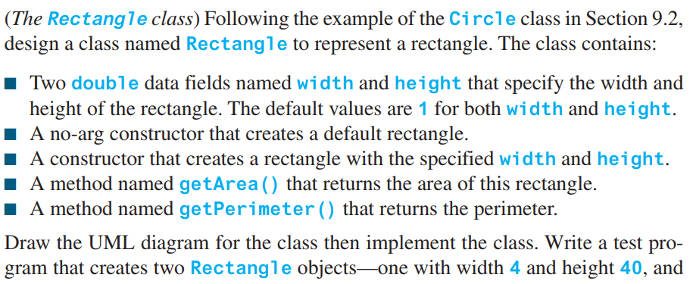
Practice

Slide 37
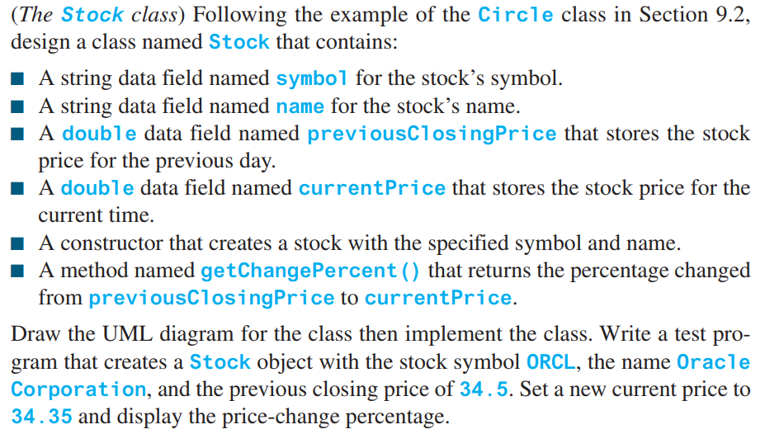
Practice

Slide 38
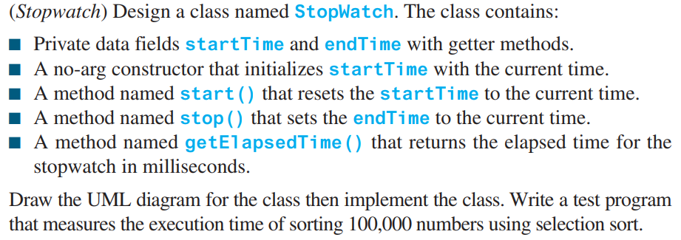
Practice
Use Date Class of Java

Slide 39
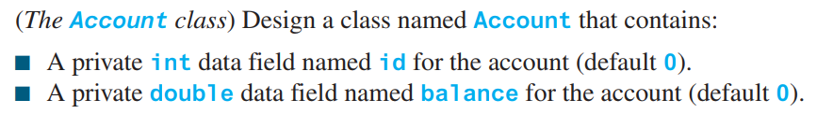
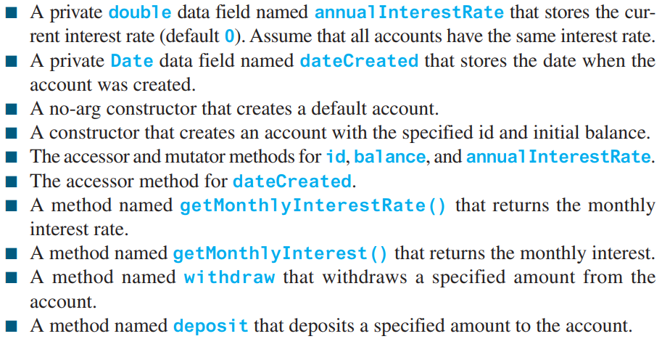
Practice

Slide 40
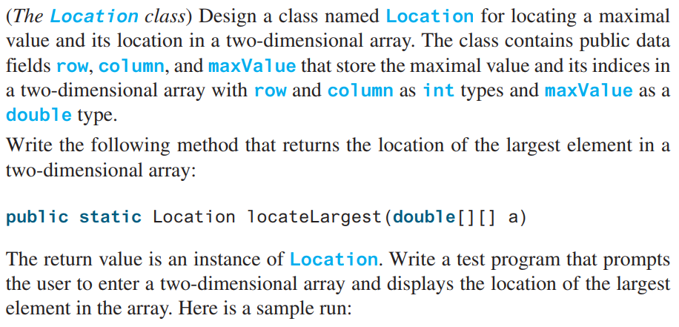
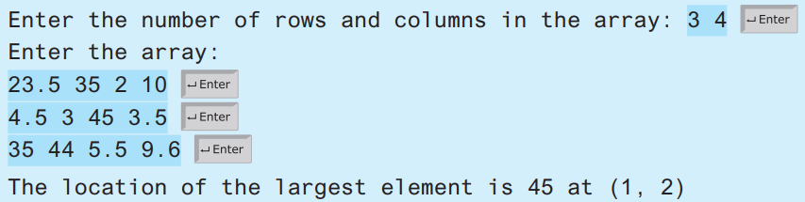
Practice

